Slide 1
SMA 2230 Lecture 2

Slide 2
Coverage
Expectation of Random variables
Properties of Expectation
Variance of R’V
Properties of Variance

Slide 3
Expectation of Random Variables
The expected value or expectation of a random variable is merely its average value, where we speak of “average” value as one that is weighted according to the probability distribution. The expected value of a distribution can be thought of as a measure of centre, as we think of the average as being middle of values.

Slide 4
Expectation of Random Variables
By weighing the value of the random variable according to the probability distribution, we hope to obtain a number that summarizes a typical value of an observation of the random variable.

Slide 5
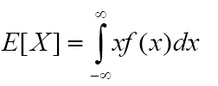
Expectation of Random Variables
Let X be a continuous random variable with probability density function f(x) . Then the expected value of is defined by the integral,

Slide 6


Expectation of Random Variables

Slide 7
Expectation of Random Variables
Example 3
Suppose that in a gambling game, a player is paid a number of shillings equal to the number of points showing when a fair die is tossed. What is the expected gain of a player in a single game?

Slide 8
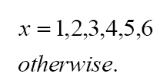
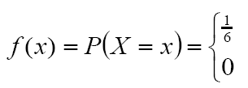
Expectation of Random Variables
Solution: Let denote the number of shillings won by the player in a single game. Then is a discrete random variable with possible values . Since the die is fair, then
Therefore the expected gain of the player is given by;

Slide 9



Expectation of Random Variables

Slide 10
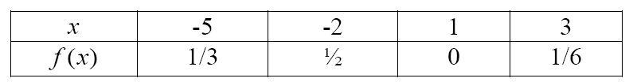

Expectation of Random Variables
Example 4
A discrete random variable has probability distribution given by

Slide 11







Expectation of Random Variables

Slide 12


Expectation of Random Variables
Let X be a continuous random variable with probability density function f(x) . Then the expected value of is defined by the integral,

Slide 13
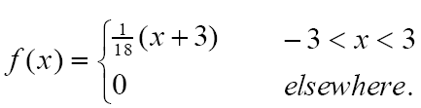

Expectation of Random Variables
Example 5
Let X be a continuous random variable with probability density function,

Slide 14

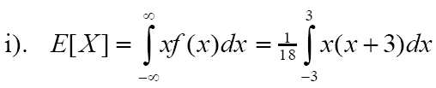



Expectation of Random Variables

Slide 15



Expectation of Random Variables

Slide 16



Expectation of Random Variables
Exercise
The time it takes for a student to finish an aptitude test (in hours has the density function

Slide 17
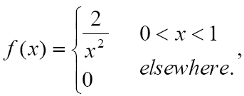
Expectation of Random Variables
Exercise
Let X be a continuous random variable
with p.d.f

Slide 18
Expectation of Random Variables
Exercise
The random variable X has the following distribution
Determine the mean of the r.v X
x | -4 | 5 | 7 | 8
p(x) | 0.59 | 0.15 | 0.25 | 0.01

Slide 19
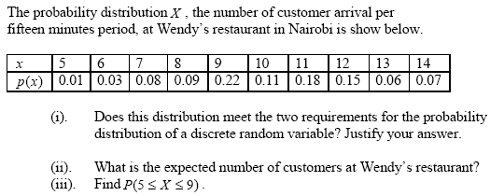
Expectation of Random Variables
Exercise
4.

Slide 20



Properties of Expectation Variables

Slide 21

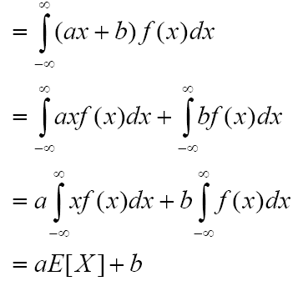

Properties of Expectation Variables

Slide 22


Properties of Expectation Variables

Slide 23
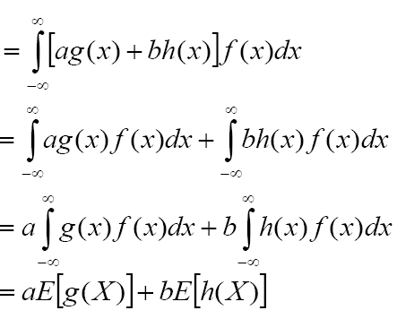
Properties of Expectation Variables

Slide 24
Properties of Expectation Variables
The two properties (1) and (2) are called linear properties of expectation. They remain valid when X is a discrete random variable, in which case the integrals are replaced by summations.

Slide 25
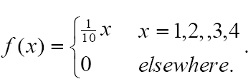

Properties of Expectation Variables
Example 6
Let X be a discrete random variable with probability mass function,

Slide 26

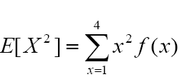




Properties of Expectation Variables

Slide 27
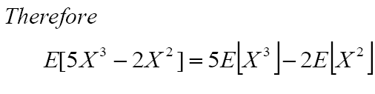

Properties of Expectation Variables

Slide 28


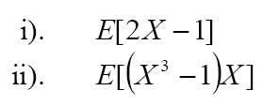



Properties of Expectation Variables

Slide 29


Moments of a Distribution
Consider a random variable with p.d.f . f(x). Then the expected value of X , if it exists, is called the mean of the random variable X or the mean of the probability distribution f(x). It is usually denoted by

Slide 30



Moments of a Distribution
This is also called the first moment about the point . In general the moment about is defined by,

Slide 31

Moments of a Distribution
and are called central moments. In any case, the exponent k is called the order of the moment and is assumed to be a non-negative integer. However we note that, the first central moment of a distribution is always zero, i.e.

Slide 32
Moments of a Distribution
However we note that, the first central moment of a distribution is always zero, i.e.
The second central moment of a distribution is commonly used as a measure of dispersion or spread of a distribution and is usually referred to as the variance of the distribution, denoted as . We write,

Slide 33
Moments of a Distribution
, while
is called the standard deviation.
Therefore, if f(x) is the density function of , then X, then

Slide 34
Moments of a Distribution
Example 1
A continuous random variable Y has probability density function given by,
Determine the mean and variance of Y.

Slide 35
Moments of a Distribution
Solution:
While the variance will be
Determine the mean and variance of Y.

Slide 36
Moments of a Distribution
Example 2
Let X be a discrete random variable with probability distribution,
Compute the mean and variance of X .

Slide 37









Moments of a Distribution
Solution:

Slide 38



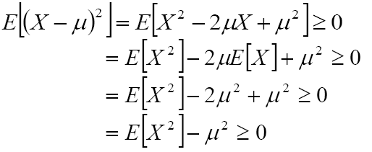

Properties of Variance

Slide 39



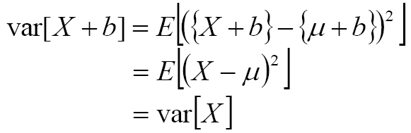
Properties of Variance

Slide 40
Properties of Variance
This implies that the variability of a random variable remains unchanged if a constant is added or subtracted from a random variable. In other words the addition or subtraction of constant only shifts the location of the distribution but its spread is unchanged, i.e. the variance is scale invariant.

Slide 41

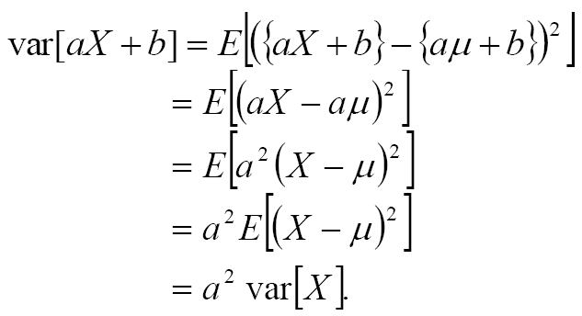
Properties of Variance

Slide 42
12:05:25 PM

